Slide 1
Research proposal on the causes of high blood pressure and the way of reducing and controlling it
Name
Institution Affiliation
Course
Date

Slide 2
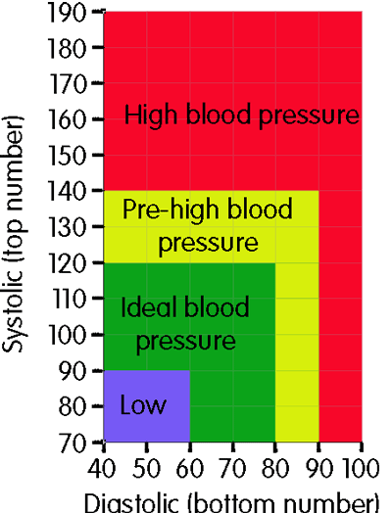
Abstract
In the modern world, the issue of high blood pressure has been a severe challenge to both adult and aging group in different parts of the world.
The current limitation is that, there have been unsatisfactory studies to investigate what cause high blood pressure and what is the possible solution for controlling the issues of high blood pressure.
Generally, there are two blood pressure readings like 140/90 mmHg.
The top reading represents an individual’s systolic blood pressure that shows the highest pressure when heart of a person beats.
The bottom reading is the diastolic blood pressure of a person. The uncontrolled high pressure is associated with other severe conditions like heart attack commonly known as the stock.
Notes:
In the modern world, the issue of high blood pressure has been a severe challenge to both adult and aging group in different parts of the world. The current limitation is that, there have been unsatisfactory studies to investigate what cause high blood pressure and what is the possible solution for controlling the issues of high blood pressure. In this paper I would like to propose to come up with a comprehensive research on the causes and the ways of controlling the high blood pressure in the modern world. Generally, there are two blood pressure readings like 140/90 mmHg. The top reading represents an individual’s systolic blood pressure that shows the highest pressure when heart of a person beats. The bottom reading is the diastolic blood pressure of a person. The uncontrolled high pressure is associated with other severe conditions like heart attack commonly known as the stock.

Slide 3
Background
My question in this proposal is what can be done to know the cause and control of the high blood complications to the individual who are above sixty five years.
To address this issue, several scholars have carried different studies to determine what really causes the high blood pressure as well as the best ways to control the risks associated with such complication.
high blood pressure is associated with hypertension and some of the factors here include diabetes, stress, obesity and inadequate intake of calcium, potassium and chronic alcohol consumption.
I will use cross-sectional studies by Tudor, H. J. (2018 to come up with the best way of reducing the risk of getting high blood pressure is thorough lifestyle changes that keep the pressure down.
Losing extra pounds as well as watching one’s waistline, exercising regularly, eating healthy diet and reducing sodium in diets is some ways that can be used in controlling high blood pressure.
Notes:
Background
My question in this proposal is what can be done to know the cause and control of the high blood complications to the individual who are above sixty five years. To address this issue, several scholars have carried different studies to determine what really causes the high blood pressure as well as the best ways to control the risks associated with such complication. Some studies have suggested that, high blood pressure is associated with hypertension and some of the factors here include diabetes, stress, obesity and inadequate intake of calcium, potassium and chronic alcohol consumption. I will use cross-sectional studies by Tudor, H. J. (2018 to come up with the best way of reducing the risk of getting high blood pressure is thorough lifestyle changes that keep the pressure down. It has been suggested that. Losing extra pounds as well as watching one’s waistline, exercising regularly, eating healthy diet and reducing sodium in diets is some ways that can be used in controlling high blood pressure. The limitations here include sample size used in analyzing research problems, unsatisfactory prior research study on the high blood pressure, the measure used in collecting data and the unreliable data on the causes and methods of controlling the risks of high blood pressure. Besides, costa, schedule and scope are constrains that forms part of limitation for this research.

Slide 4
objectives
The aims of this research include:
Investigating the cause of high blood pressure in young adults and gaining population above sixty five years.
Determining the measures to control and reduce the risks of high blood pressure
Recommending what has already been done to control the risk of high blood pressure
Notes:
Objectives
To overcome the limitations as mentioned I propose to use a considerable sample size of a population affected by the high blood pressure, conducting a satisfactory prior research on the high blood pressure taking an effective measure of collecting data and using a reliable data to address the causes and measures to control the risks of high blood pressure. The aims of this research include:
Investigating the cause of high blood pressure in young adults and gaining population above sixty five years.
Determining the measures to control and reduce the risks of high blood pressure
Recommending what has already been done to control the risk of high blood pressure

Slide 5
Significance and Innovation
Significance
I intend to use approaches like, methodological study, descriptive study approaches and explanatory study.
Use of methodological study, helps in advancing this field by devising, testing and improving on the new based research methods.
Study will help in assessing the extent at which health research need to be embraced to focus on the health of individual who at a high risk of acquiring high blood pressure.
My approaches will be beneficial to the patients, healthcare system and the society
Innovation
My approaches are very innovative in the sense that they will involve application of newly developed techniques for by the management for healthcare planning.
The approaches will also be touching hypothetical formulation and collection of recorded empirical data about healthcare system.
Notes:
Significance
In this research I will propose to use different types of research approaches like, methodological study, descriptive study approaches and explanatory study. For instance, by use of methodological study, it will be possible to advance this field by devising, testing and improving on the new based research methods. In this way, the study will develop special techniques to assess the extent at which health research need to be embraced to focus on the health of individual who at a high risk of acquiring high blood pressure. My approaches will be beneficial to the patients, healthcare system and the society since they will be focusing on what patients need to know about their health, they will focus on the areas that healthcare system should improve in controlling and reducing the high blood pressure and informatively creating awareness to the society on the best way to avoid the risk of being a victim of high blood pressure.
Innovation
My approaches are very innovative in the sense that they will involve application of newly developed techniques for by the management for healthcare planning. The approaches will also be touching hypothetical formulation and collection of recorded empirical data about healthcare system. Through these approaches I will be addressing several things that may contribute to the high blood pressure. Some of the issues the wile covered in this research are smoking, body overweight, stress, older age and genetic. Other key issues for the high blood pressure include complications related to chronic kidney diseases, thyroid and adrenal disorders, alcohol consumption as well as taking too many salts in their diet.

Slide 6
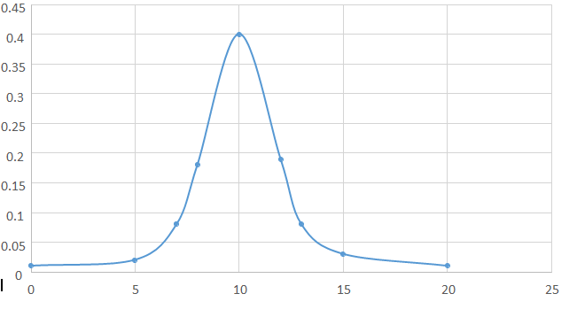
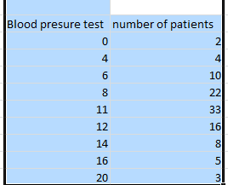
Preliminary data
In estimating the probabilities I decided to express the Y axis as proportion (%) of the patient suffering from blood pressure in each of the group.
From above table it can be observed that probability take a random variable that involves taking of specific values.
I can approximately say that 40% from above of population data will have high blood pressure with is equivalent to 10.
PSA test results | Proportion/fraction of patients
0 | 2/100
4 | 4/100
6 | 10/100
8 | 22/100
11 | 30/100
12 | 16/100
14 | 8/100
16 | 5/100
20 | 3/100
Notes:
I did a research of one hundred patient suffering from blood pressure in different health care. The patient were tested and the result was analyzed in table below. In estimating the probabilities I decided to express the Y axis as proportion (%) of the patient suffering from blood pressure in each of the group.
Graph showing the probability of each blood pressure test against test result values.
From above table it can be observed that probability take a random variable that involves taking of specific values.
I can approximately say that 40% from above of population data will have high blood pressure with is equivalent to 10.
In addition, bsed on the approaches that I have tested on their usefulness before this proposal I have a portion of some data and information about the current health statistics. I have researched for enough information from the Tohoku journal of experimental medicine by Vesey & Gobe, (2017) to validate on the causes of high blood pressure within our generation. I have used a descriptive study on the global health observatory that has suggested something to do on the increased cases of blood pressure. According to the situation and global health trade there is a raised blood pressure worldwide which has been estimated to have caused at least 7.5 million deaths. The descriptive study approach shows that increased rate of high blood pressure is the contributing factor for ischemic condition hemorrhagic stroke and coronary heart disease. Further, the approach has revealed that the adults aged 25 years and above in 2008 was around 40% within the world population.

Slide 7
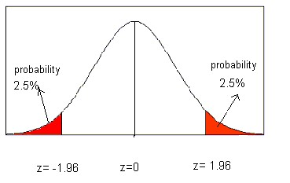
Normal distributions
Normal distributions
The probability area that is colored red that is 2.5% consist of the mean and the standard deviation. The confidence level is 95% which means that 95% of the populations fails in the interval.

Slide 8
Research strategy
To succeed in this I am planning to use both primary and secondary data so as to get both qualitative and quantitative research methods.
I will get the data from health population surveys collected in 20th century since are publically available and this means I will have nothing to do in collecting them.
I will use observation and question is to collect the data and analyze them by use of both descriptive and inferential statistics because they give more information that lead to a good conclusion.
Inadequate sample, scope and lack of adequate study are the potential limitations in this approach. If this approach will not work I will use a descriptive study approached based on well written health cross-sectional studies.
I wish to use qualitative research method in determining the measures to control and reduce the risks of high blood pressure.
Recommending what has already been done to control the risk of high blood pressure is the third aim of this proposal that I need to achieve by use of explanatory study approach. I will use both primary and secondary data by use of both qualities and quantitative research methods
Notes:
Research strategy
Investigating the cause of high blood pressure in young adults and gaining population above sixty five years is the first aim that I need to achieve through the methodological study approach. To succeed in this I am planning to use both primary and secondary data so as to get both qualitative and quantitative research methods. I will get the data from health population surveys collected in 20th century since are publically available and this means I will have nothing to do in collecting them. I will use observation and question is to collect the data and analyze them by use of both descriptive and inferential statistics because they give more information that lead to a good conclusion. Since I have enough sample and the expected outcome it to show what has been causing high blood pressure for the last three years which is actually the outcome of this aim and I will use to evaluate of outcome is good or not. I will test the rigor of my model based on the outcome of the model. Inadequate sample, scope and lack of adequate study are the potential limitations in this approach. If this approach will not work I will use a descriptive study approached based on well written health cross-sectional studies.
Determining the measures to control and reduce the risks of high blood pressure is the second aim that I expect to achieve by use of descriptive study approach. In this approach I wish to use qualitative research method. I will get data from the world health organization published articles on the current health statistics. I am also planning to use descriptive statistics in analyzing the data. I am sure they have enough sample and this means I am expecting to positively determine the measure for reducing the high blood pressure. By achieving this aim I will be able to judge if the descriptive study approach is has resulted to good outcome.
Recommending what has already been done to control the risk of high blood pressure is the third aim of this proposal that I need to achieve by use of explanatory study approach. I will use both primary and secondary data by use of both qualities and quantitative research methods. I will use observation and question is to collect the data and analyze them by use of both descriptive and inferential statistics because they give more information that lead to a good conclusion. Since I have enough sample and the expected outcome it to show what has been causing high blood pressure for the last three years which is actually the outcome of this aim and I will use to evaluate of outcome is good or not. I will test the rigor of my model based on the outcome of the model. Inadequate sample, scope and lack of adequate study are the potential limitations in this approach. If this approach will not work I will use a historical study approached based on well written health cross-sectional studies.

Slide 9
References
Bundy, J. D., Li, C., Stuchlik, P., Bu, X., Kelly, T. N., Mills, K. T., & He, J. (2017). Systolic blood pressure reduction and risk of cardiovascular disease and mortality: a systematic review and network meta-analysis. JAMA cardiology, 2(7), 775-781
Forouzanfar, M. H., Liu, P.,Roth, G. A., Ng, M., Biryukov, S., Marczak, L., & Ali, R. (2017). Global burden of hypertension and systolic blood pressure of at least 110 to 115 mm Hg, 1990-2015. Jama, 317(2), 165-182.
Satarug, S., Vesey, D. A., & Gobe, G. C. (2017). Kidney cadmium toxicity, diabetes and high blood pressure: the perfect storm. The Tohoku journal of experimental medicine, 241(1), 65-87.
Tudor, H. J. (2018). Hypertension: community control of high blood pressure. CRC Press.

